Slide 1



CODE BASICS Resume Challenge #6
Aniket Kumar Ray

Slide 2

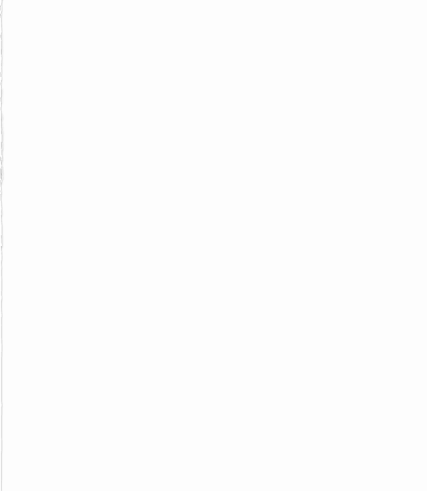
Provide Insights to the Marketing Team in Food & Beverage Industry
CodeX, a German beverage company, recently launched its energy drink in 10 cities in India.
The Marketing team is focused on increasing brand awareness, market share, and product development in the Indian market.
To gather insights, the team conducted a survey among 10,000 respondents in the 10 cities where the energy drink was launched

Slide 3
Primary Insights
Demographic Insights
Consumer Preferences
Competition Analysis
Marketing Channels and Brand Awareness
Brand Penetration
Purchase Behaviour
Product Development

Slide 4
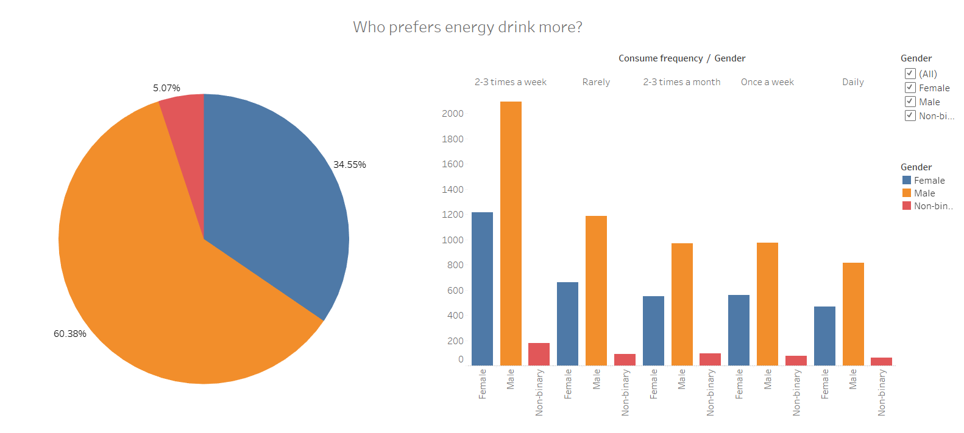
Demographic Insights
Who prefers energy drink more? (male/female/non-binary?)
We can see that 60.38% of the total respondent were male.
Male demographic is seen to be dominant in all frequency of intake as well.

Slide 5
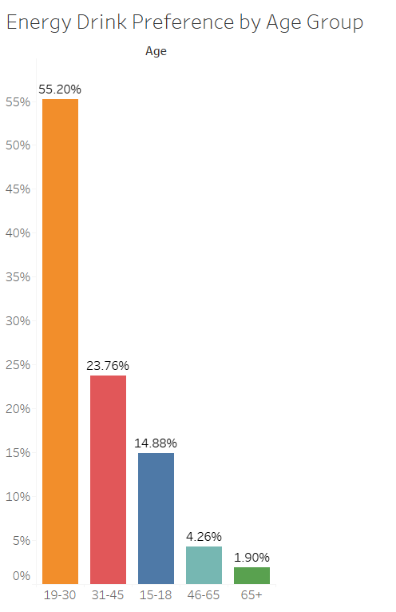
Demographic Insights
Which age group prefers energy drinks more ?
We can see 19 - 30 age segment dominating the preference demographic followed by 31 – 45 age group.
Around 78.96 % of the total sample population falls under the age gp of 19- 45, which is the major working class of India

Slide 6
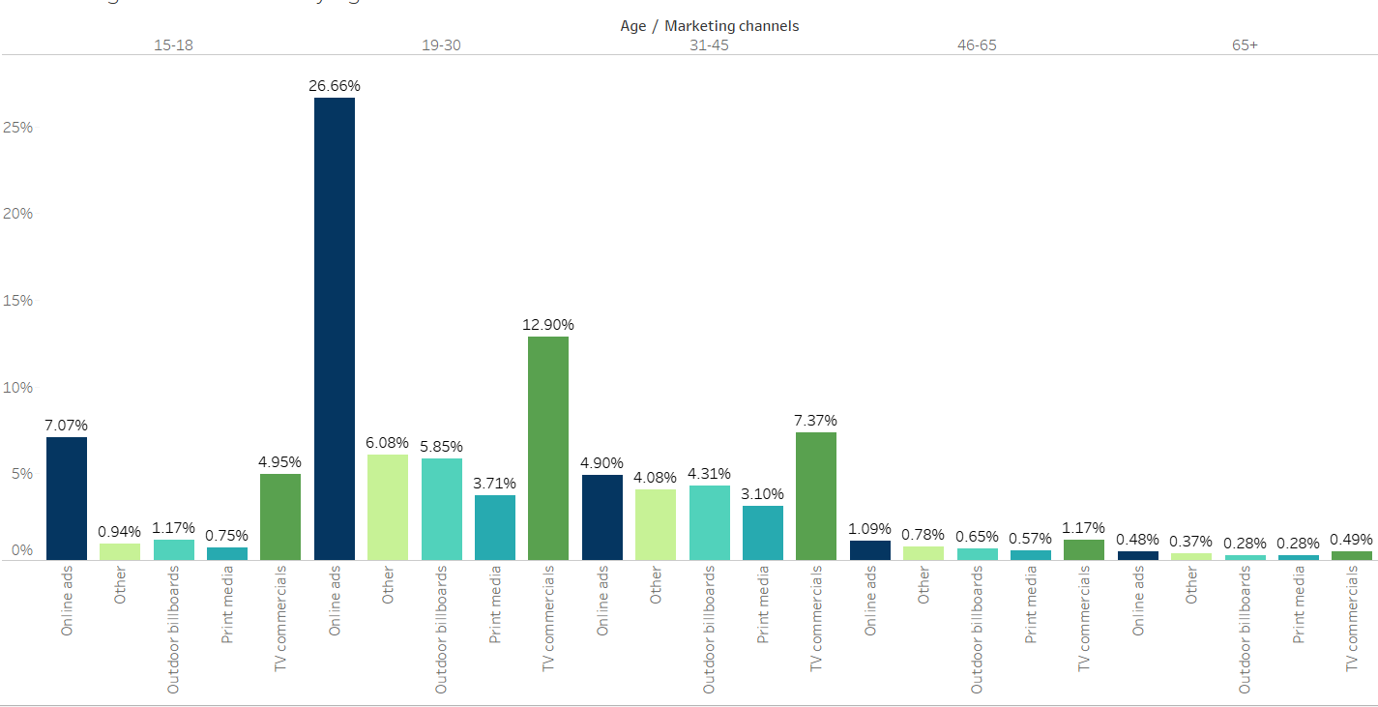
Demographic Insights
Which type of marketing reaches the most Youth (15-30)?
The graph indicates that online ads followed by Tv commercial are the leading marketing reach for the youth demographic

Slide 7
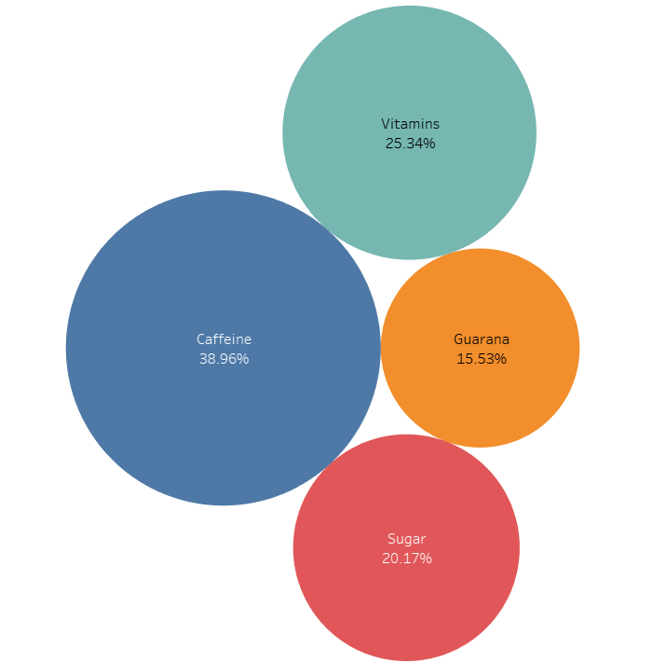
Consumer Preferences
What are the preferred ingredients of energy drinks among respondents?
Caffeine tops the list as 38.96 % prefer caffeine in their energy drink followed by Vitamins by 25.34% respondent

Slide 8
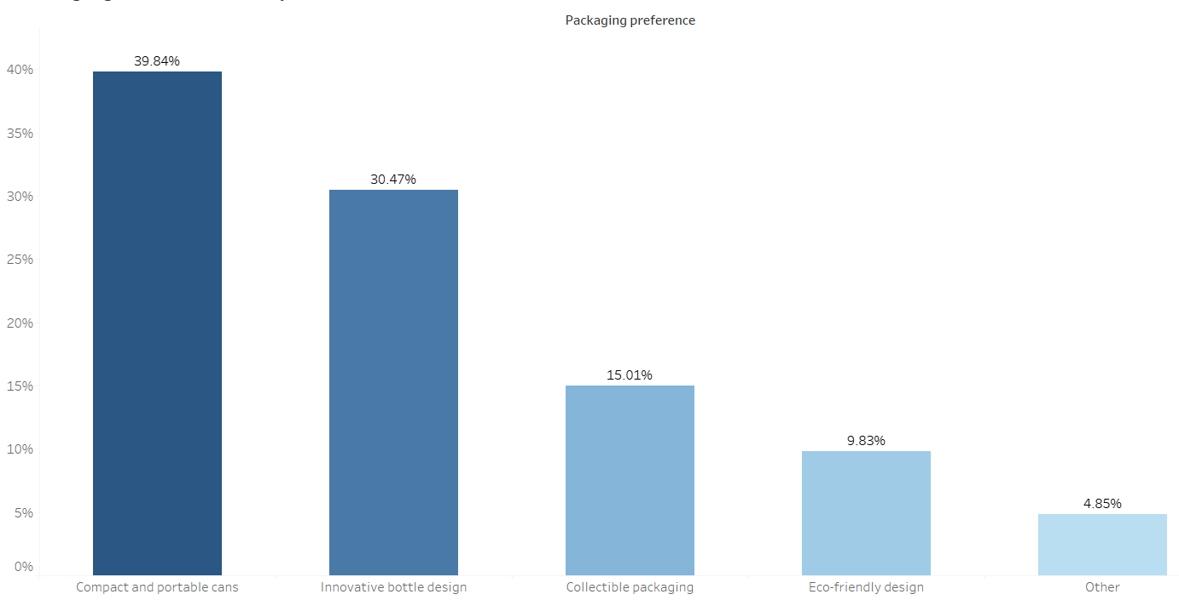
Consumer Preferences
What packaging preferences do respondents have for energy drinks ?
Compact and portable cans are preference of majority (39.84%) followed by innovative bottle design (30.47%)

Slide 9
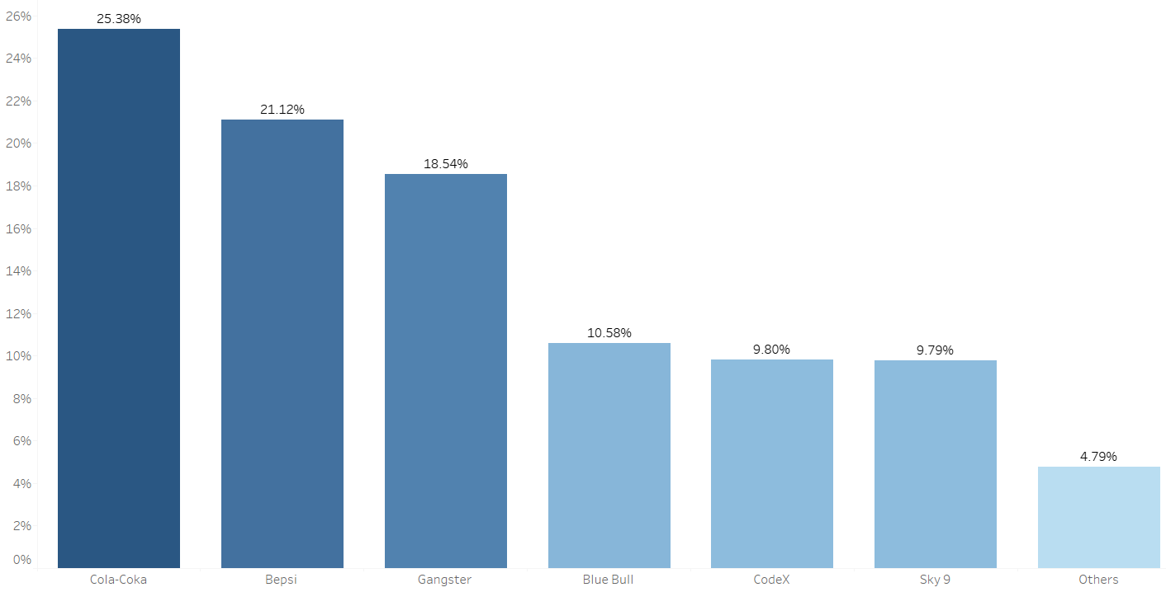
Competition Analysis
Who are the current market leaders?
Cola-Coka is the market leader with 25.38% market share followed by Bepsi with a market share of 21.12%.
Our brand is on the 5th place with a market share of 9.8%

Slide 10
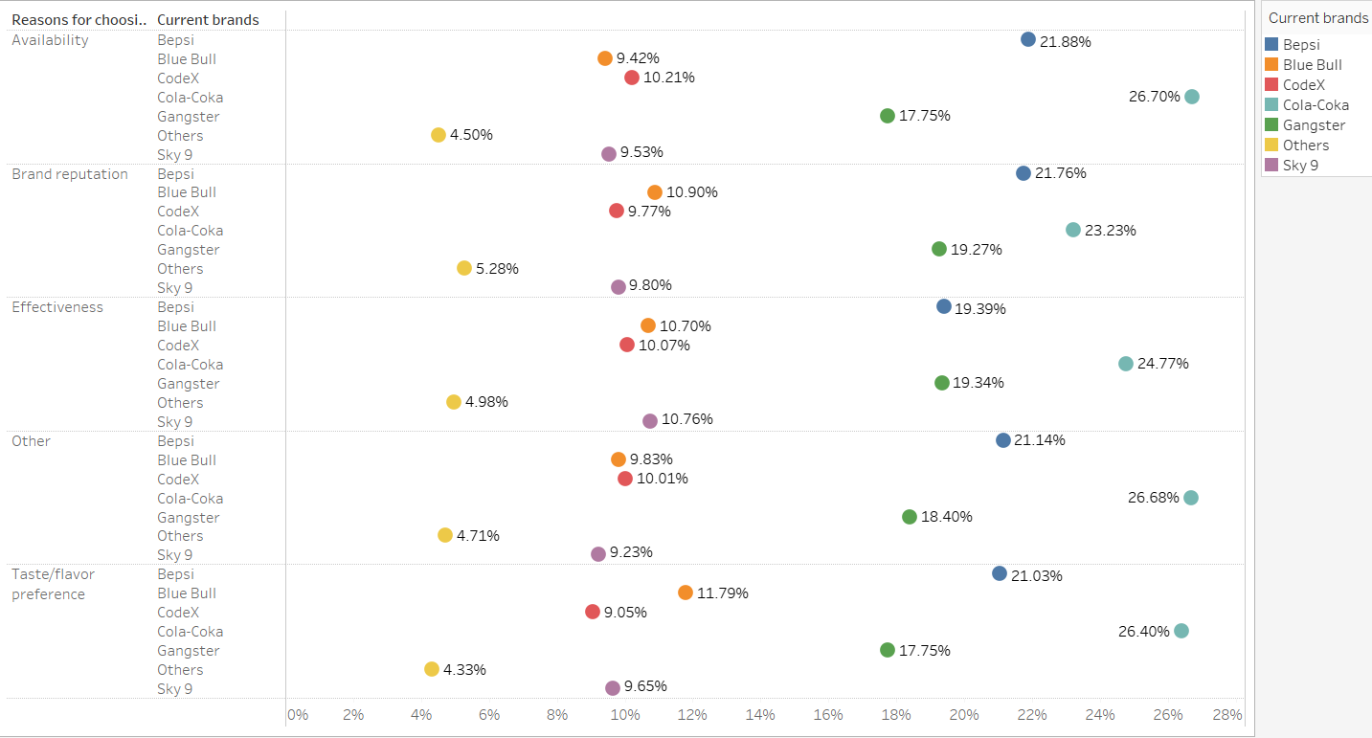
Competition Analysis
What are the primary reasons consumers prefer those brands over ours?
The consumers 1st preference is Brand reputation followed by taste/ flavour.
In all the 5 categories i.e. brand reputation, taste, availability, effectiveness and other we have a lot of room for growth

Slide 11
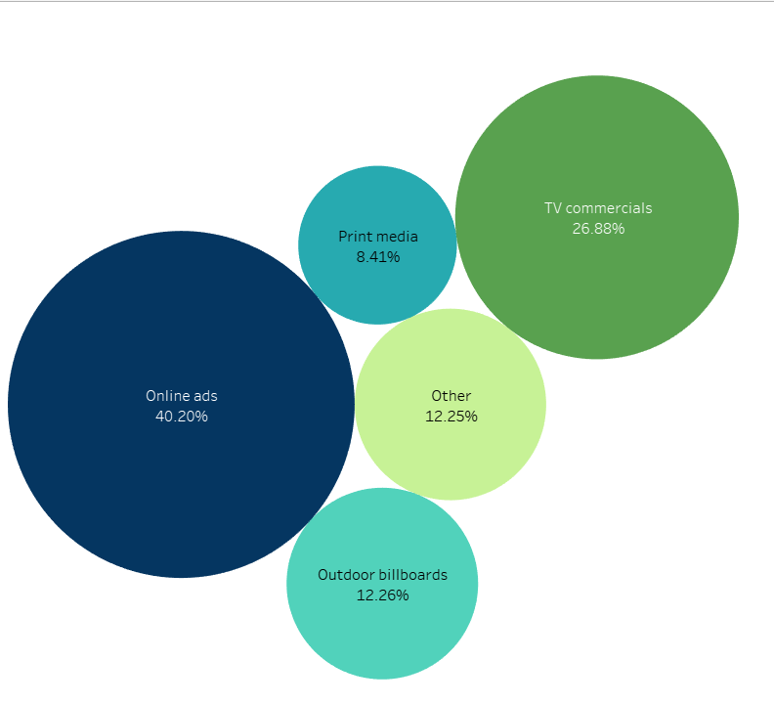
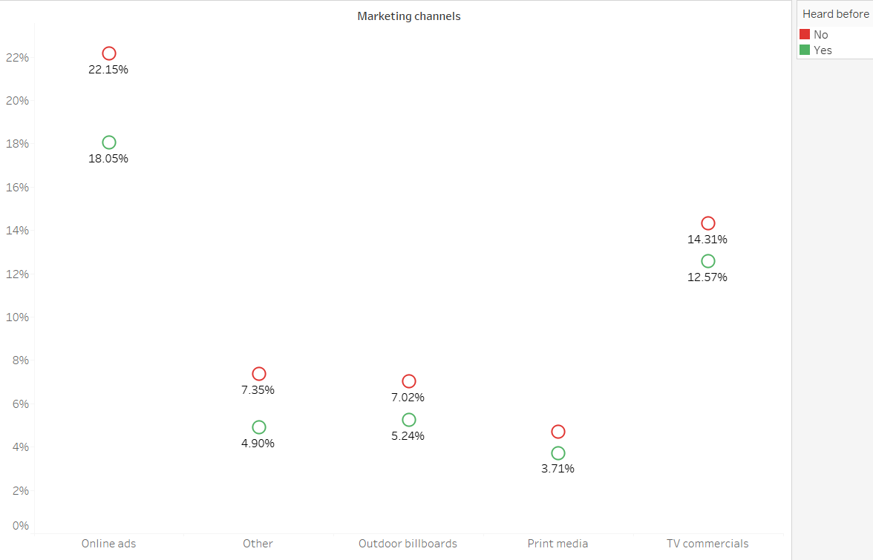
Marketing Channels and Brand Awareness:
Which marketing channel can be used to reach more customers and effective are different marketing strategies and channels in reaching our customers?
Online ads reach around 40.2% of our total demographic.
A total of 55.53 % of the sample has never heard about us

Slide 12
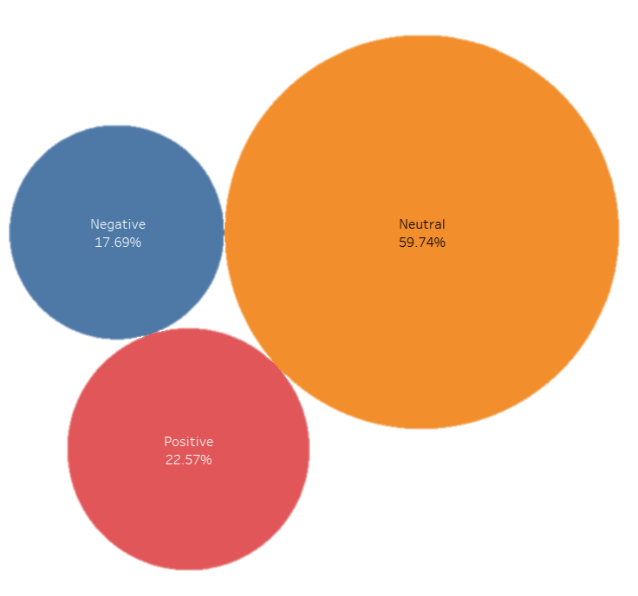
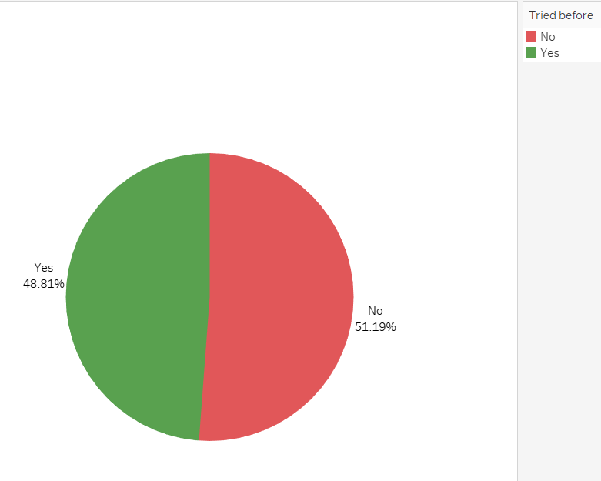
Brand Penetration
807
2561
What do people think about our brand? (overall rating)
We have a neutral image in the market.
Of all the respondent 51.19 % has never tasted our brand which does show a scope of setting up a positive image .
1079

Slide 13
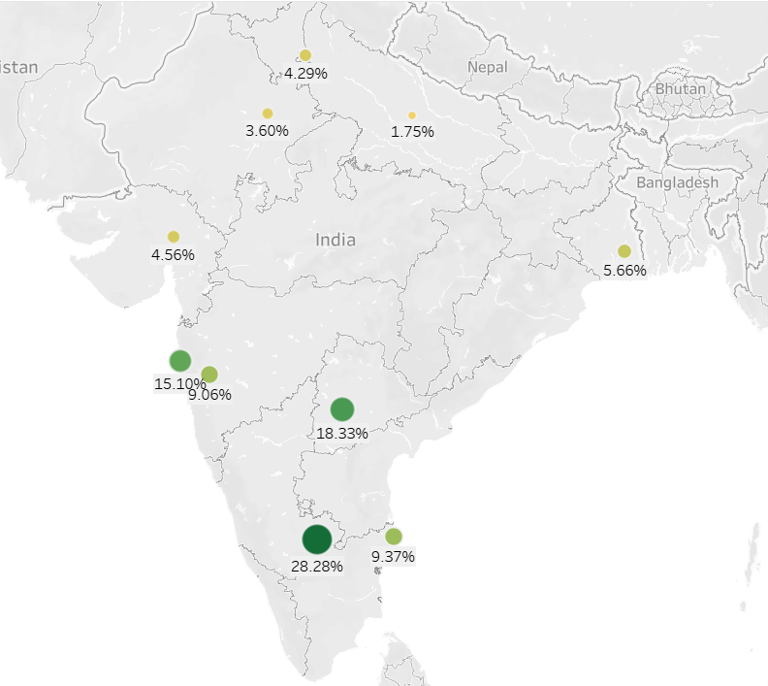
Brand Penetration
Which cities do we need to focus more on ?
Our brand is more prominent in Bangalore, Hyderabad, Mumbai and Pune.
Growth potentials in Delhi, Ahmedabad and Kolkata is present as they are big markets with our small presense.

Slide 14
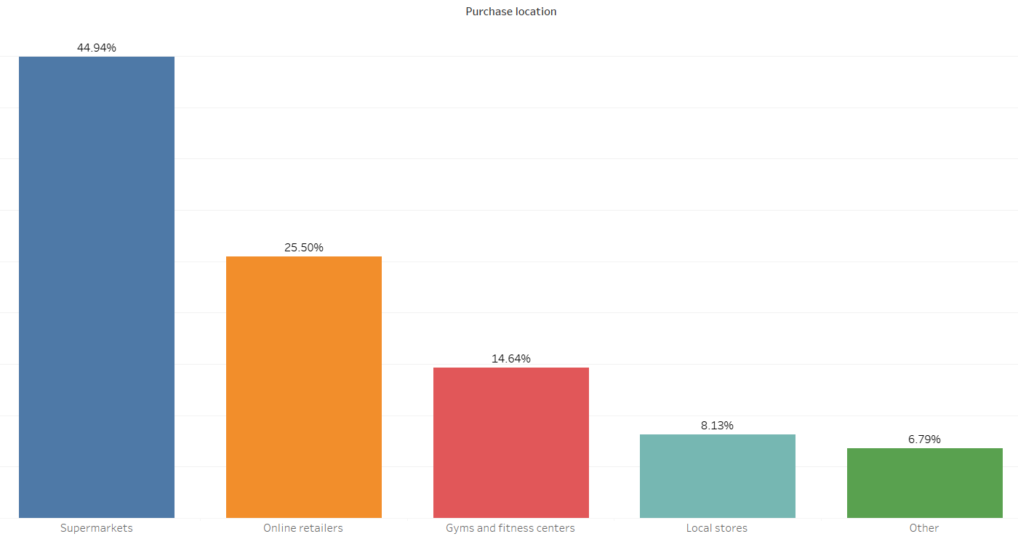
Purchase Behaviour
Where do respondents prefer to purchase energy drinks?
Majority (44.94%) buy their energy drink supply from the supermarkets followed by Online retailers (25.5%)
If we target supermarkets and online retailers we can cover 70.44 % of the purchase market.

Slide 15
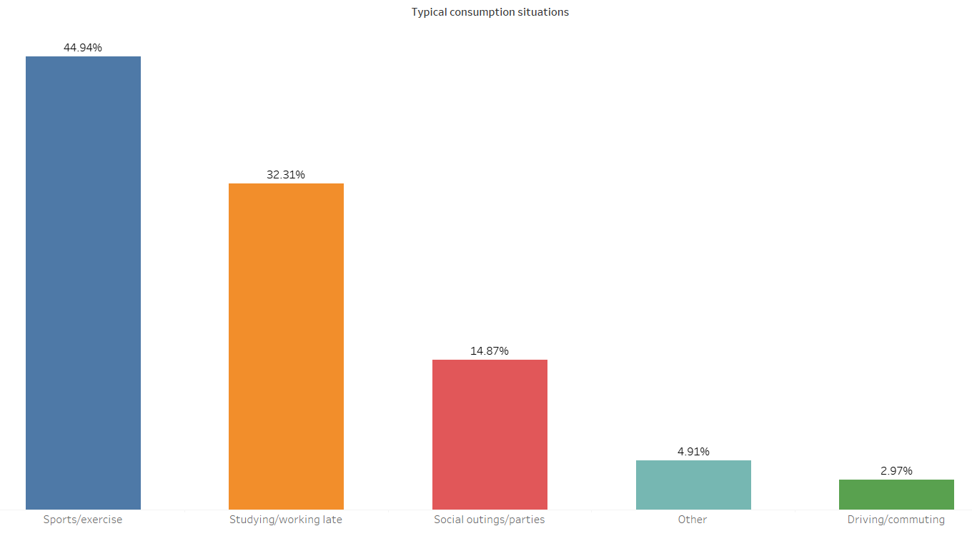
Purchase Behaviour
What are the typical consumption situations for energy drinks among respondents?
Majority use energy drink for sports/exercise (44.94%) followed by studying/working late (32.31%)
If we target these consumption situation we can get 77.25 % of the market

Slide 16
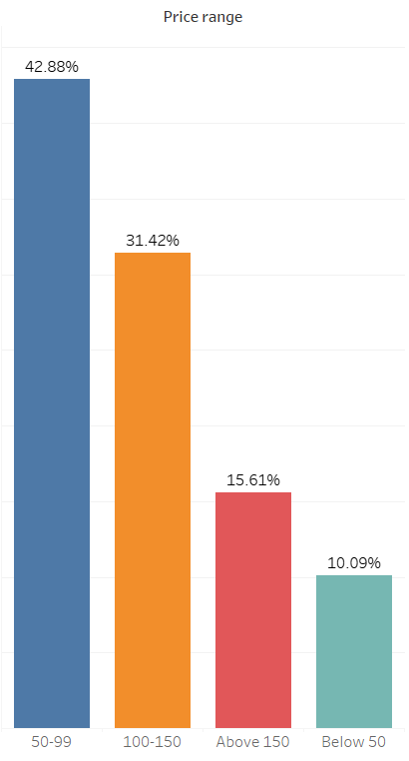
Purchase Behaviour
What factors influence respondents' purchase decisions, such as price range ?
42.88 % of the sample size prefer the price range of 50 – 99 and 31.42 % prefer price range of 100 -150.
We can use these range to attract customer base by providing discounts to keep prices in these range

Slide 17
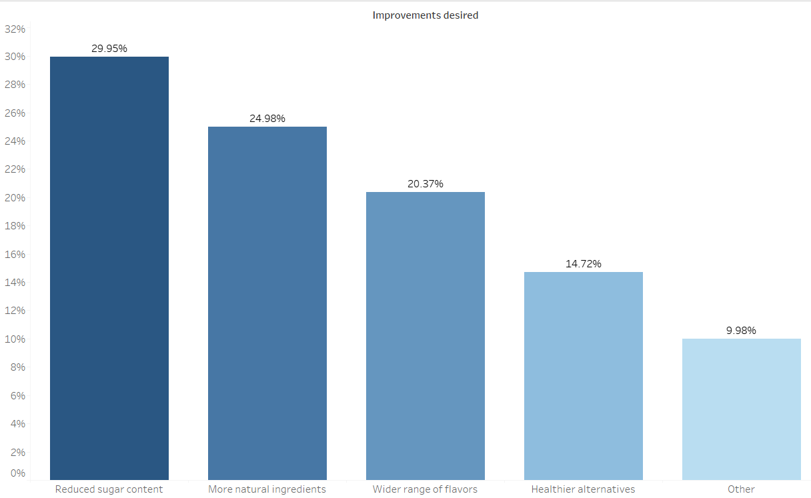
Product Development
Which area of business should we focus more on our product development ?
We can see people desire improvement in sugar content, more natural ingredients and wide range of flavours.
This shows us that there is an unexplored market for sugar free energy drinks which can contain natural ingredients and flavours

Slide 18
Recommendations for CodeX
We can go for a sugar free variant with a compact and designer container
The product should within a price range of 50 to 150, it can be different volume variants that cover all these price segments
The most effective marketing would be on online media and tv commercials as they have the maximum reach, we can also offer products on discount in super market chains as maximum purchase happen in super markets. A penetrative strategy would be preferred
Social media influencers from the city of Delhi, Kolkata , Ahmedabad should be preferred as major brand awareness is coming from online platform and these cities have large populations but less exposure to our product.
Males within the age group 19- 45 who are into sports/exercise or are late working individuals should be the first target

